Slide 1



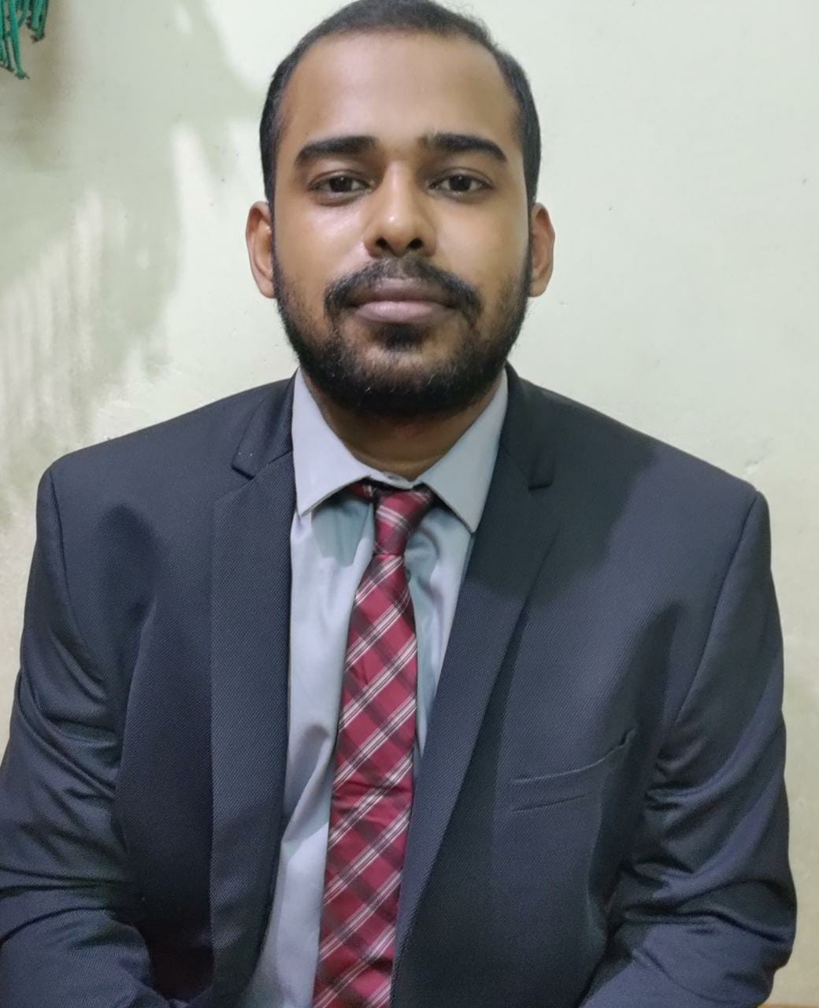
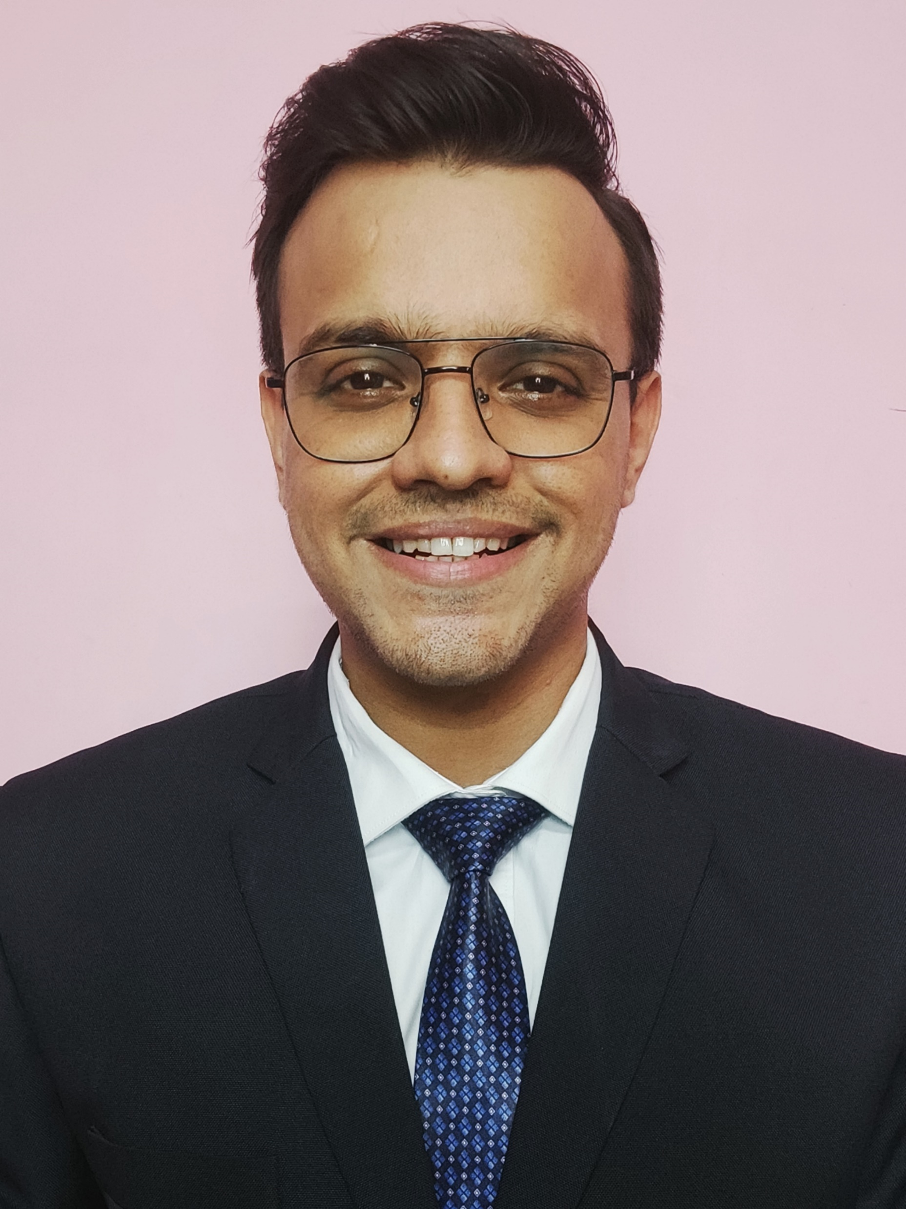
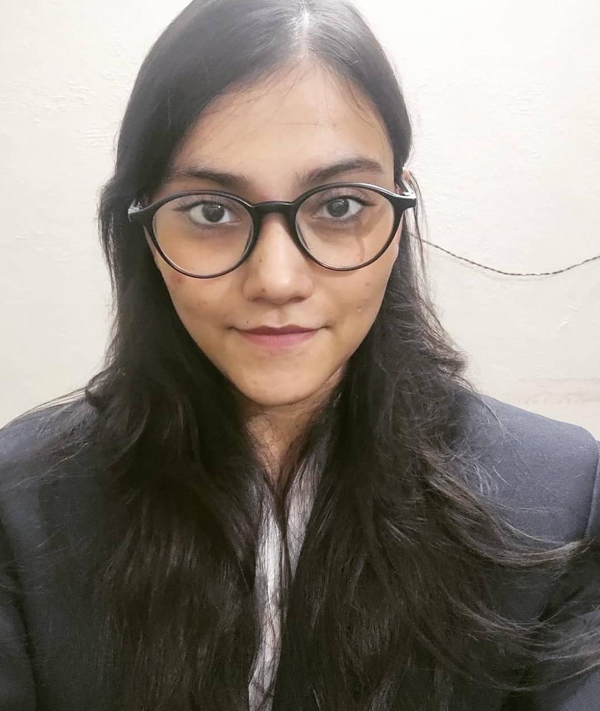
PRODUCT DECODE
Team SORTED
Product Teardown
Devesh Sinha Mohit Kiradoo Kajal Gupta
T. A. Pai Management Institute

Slide 2




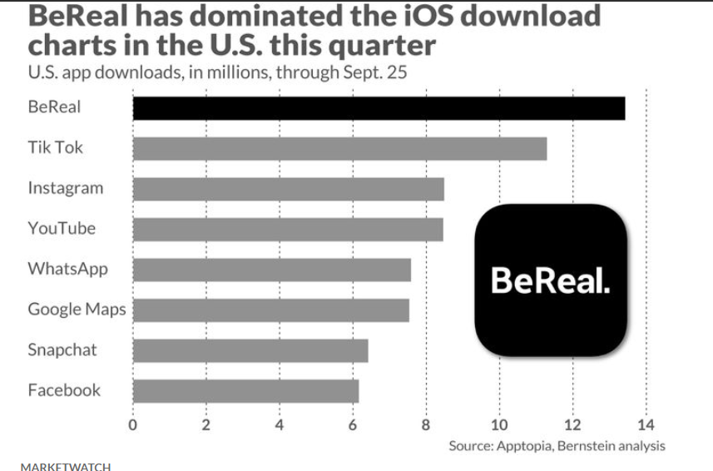




Overview
Influencer Persona
User Journey
Feature Improvements
Success Metrics
About
BeReal is a free social media app that asks users to take a quick snapshot of an ‘authentic moment’ during their day to share with their followers. There are no filters or opportunities to stage the ‘perfect photo’ – what you see is what you get. It is formatted to make the user show their ‘real self’.
The French social media app which was released in 2020, was developed by Alexis Barreyat and Kevin Perreau.
MISSION
"BeReal wants to be beacon of change in social media & create a healthier & real version of it."
VISION
To create “an alternative to addictive social networks” that focus on amassing influence
Key Value Proposition
The Ecosystem
Platform Performance
Exclusive Platform
Notifications
10 MN+ downloads on Playstore
Daily Active Android Users: 2.9 MN
Content Providers
Information Providers
User Ratings: 4.6
Daily Active iPhone Users: 3.93 MN
Authentic
User Friendly
Competitors
Direct
Indirect

Slide 3




Overview
Influencer Persona
User Journey
Feature Improvements
Success Metrics
PERSONA 1
PERSONA 2
PERSONA 3
PERSONA 4
PROFILE
Kajal Gupta
Age: 25
Profession: Consultant
Adira Nair
Age: 23
Profession: Fashion Designer
Rohan
Age: 27
Profession: MBA Student
Eshita
Age: 27
Profession: Software Developer
Kajal is a food influencer hence loves experimenting new cuisines and restaurants. She likes posting videos and photos of food and the places on different social media platforms
Adira is a fashion and makeup influencer. She shares fashion and makeup tutorials through videos or reels on profile. She has a huge follower base on Instagram and other social media platforms
Rohan is a post graduate student who loves going to the gym regularly. He wants to become gym trainer in the future. He is very active on social media platforms and has a good follower base
Eshita is a frequent traveler. She likes exploring new places. She goes on long trips with her friends and likes sharing her travel experience on the social media through posts or vlogs
USER BEHAVIOR
EXPECTATION
She wants to try this app, learn about how its features can capture candid moments
She wants to post candid photos at her own time during the day while she is busy pursuing her hobby
She wants to post candid pre and post workout photos and the diet he follows during the day
She wants to capture and share candid moments of her trips through the app
GOAL
Wants to limit social media usage and simultaneously increase productivity
Wants to limit social media usage and simultaneously increase productivity
Wants to limit social media usage and simultaneously increase productivity
Wants to limit social media usage and simultaneously increase productivity
PAIN POINT
Wants to have a feature where she can directly add caption along with the photo
Random notifications of the app makes it a bit difficult for her to give candid view of her work
Wants a video feature on the app to post candid gym videos and workouts
Wants a video feature and wants to have the option to put multiple posts
FEATURE
Captions while posting
Specific notification timing
Video posts
Video posts

Slide 4
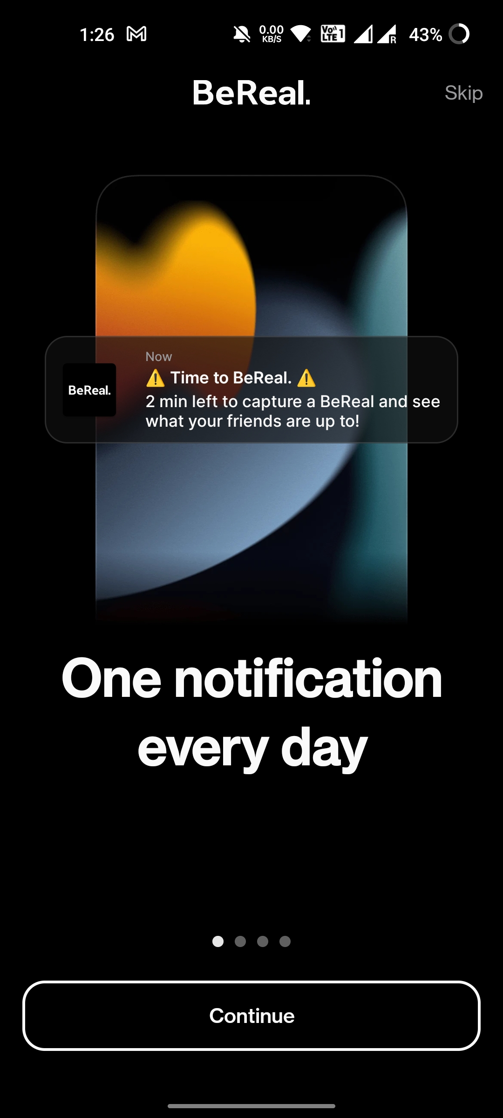
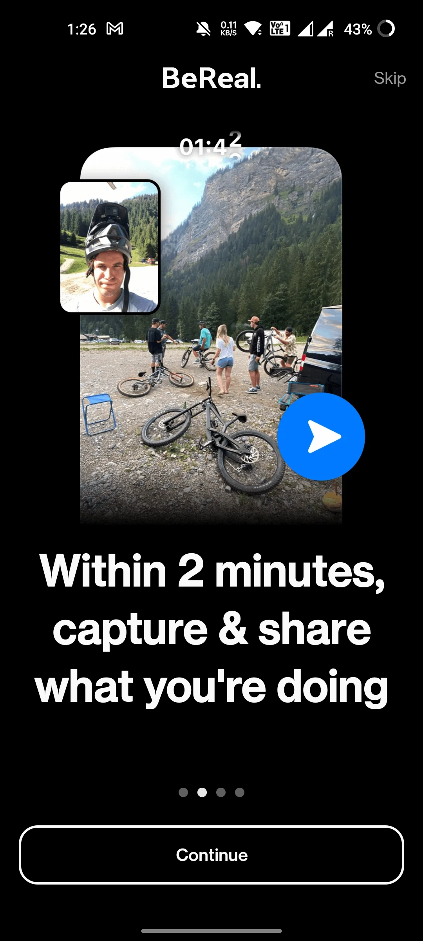
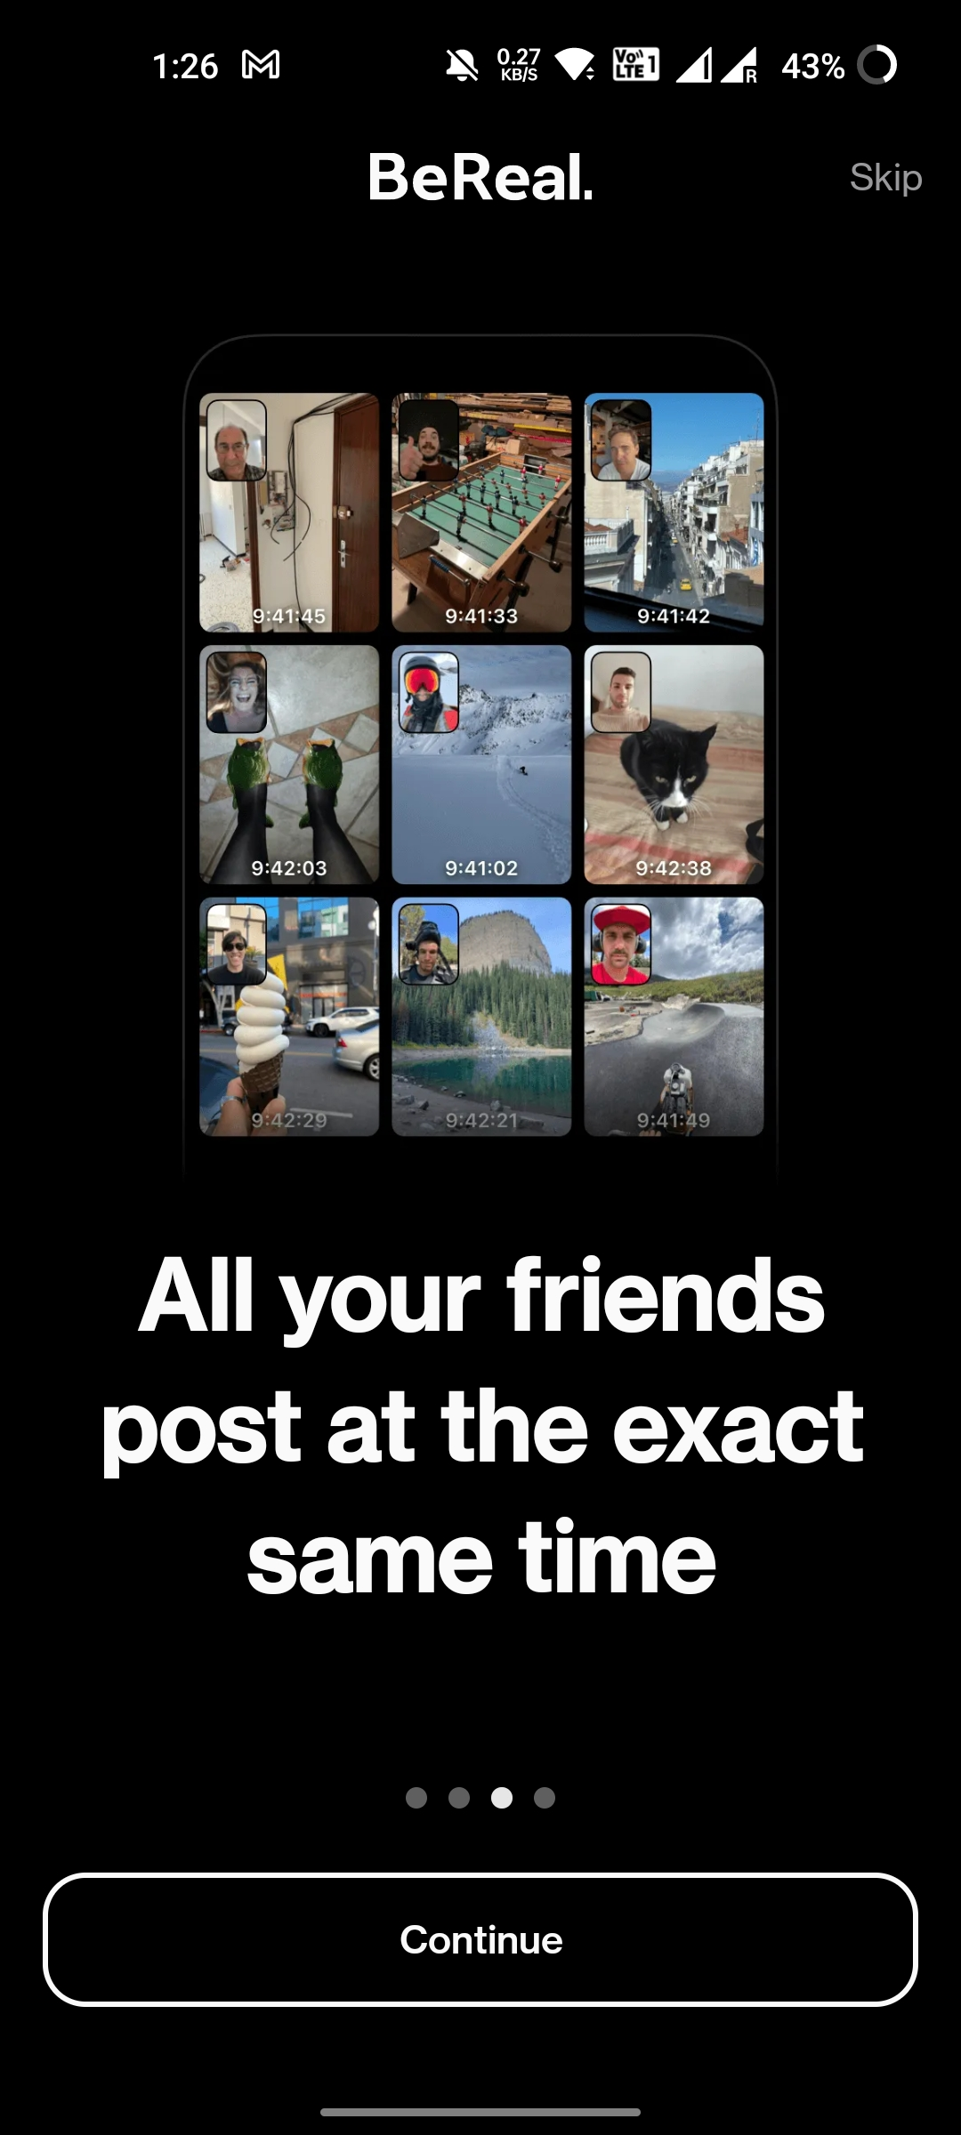
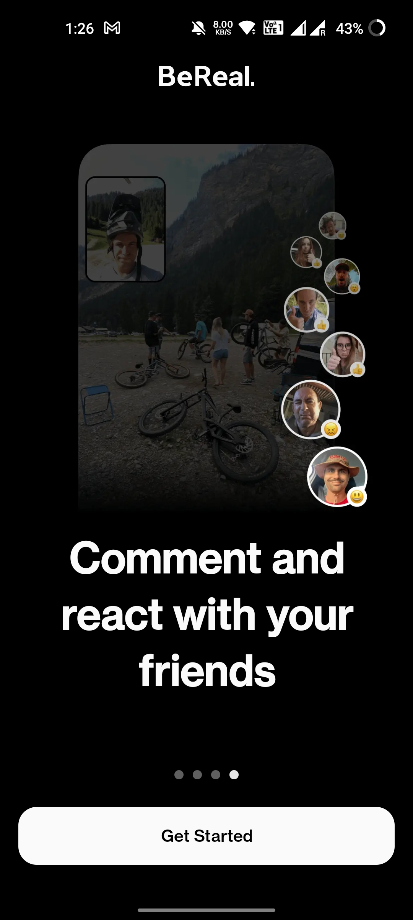
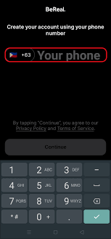
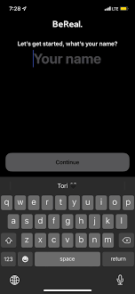
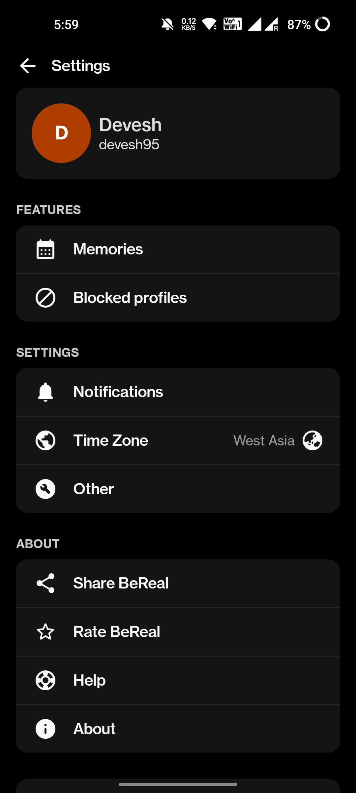
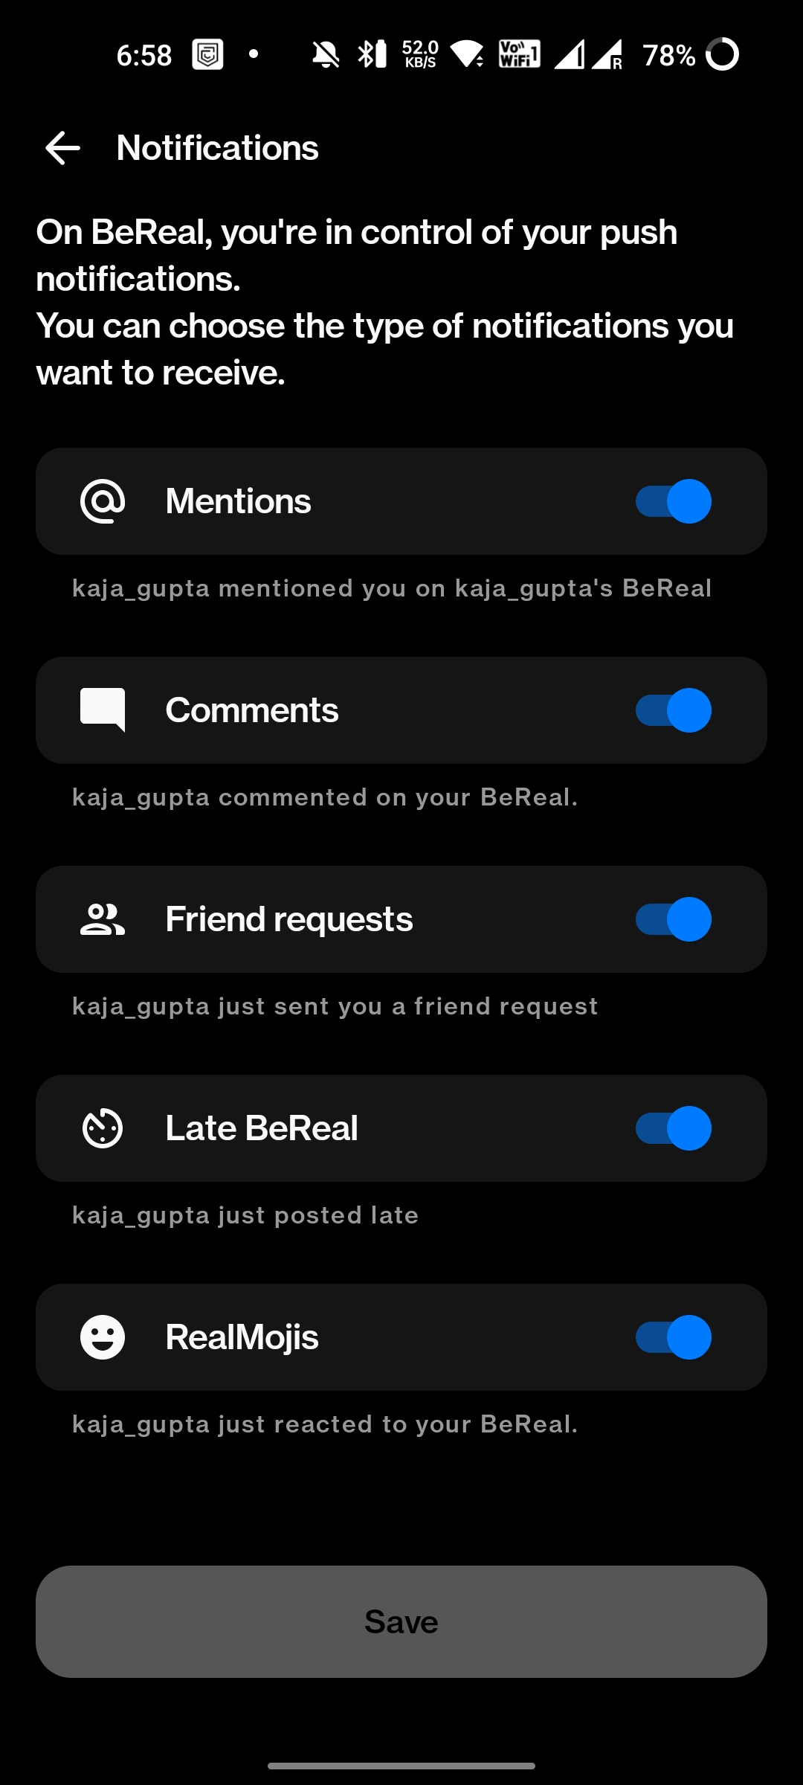
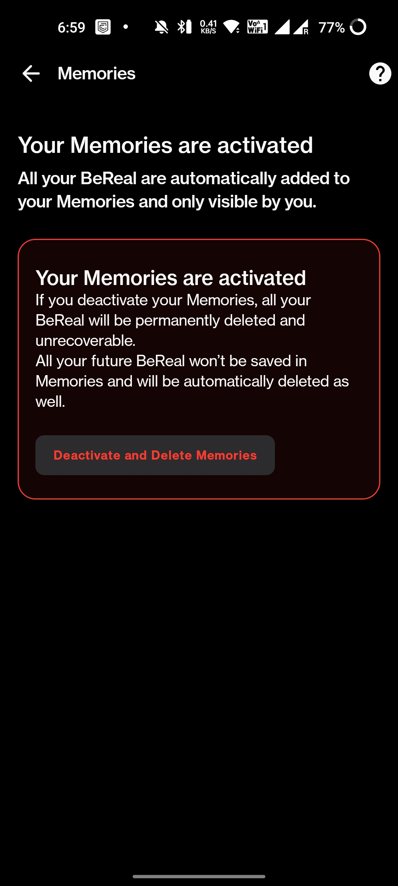
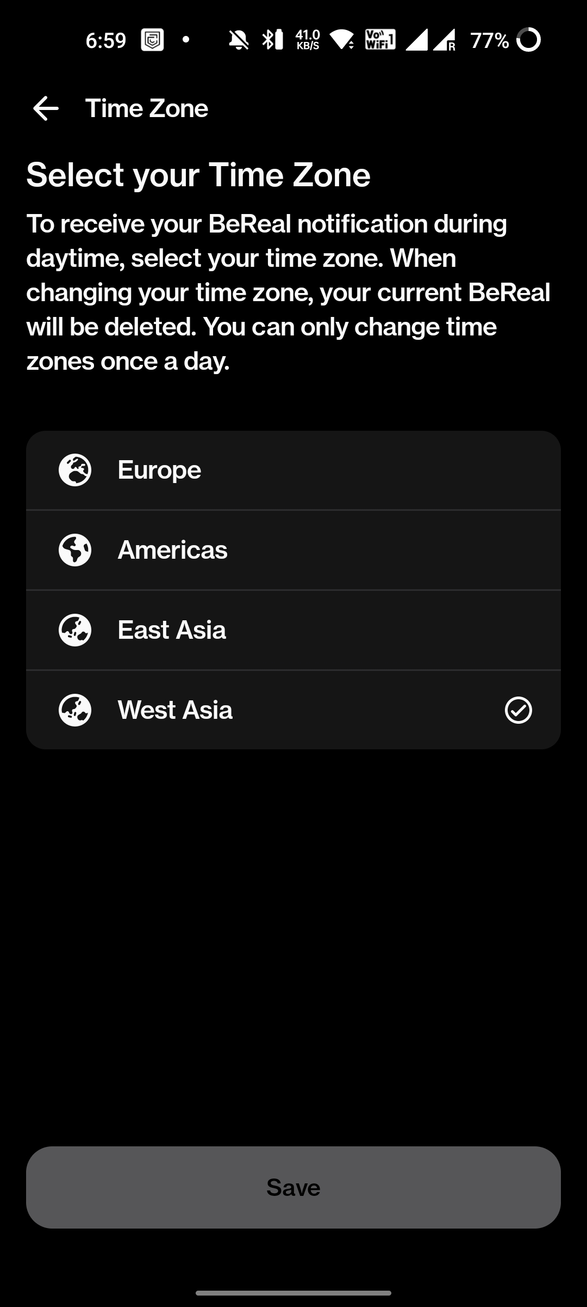
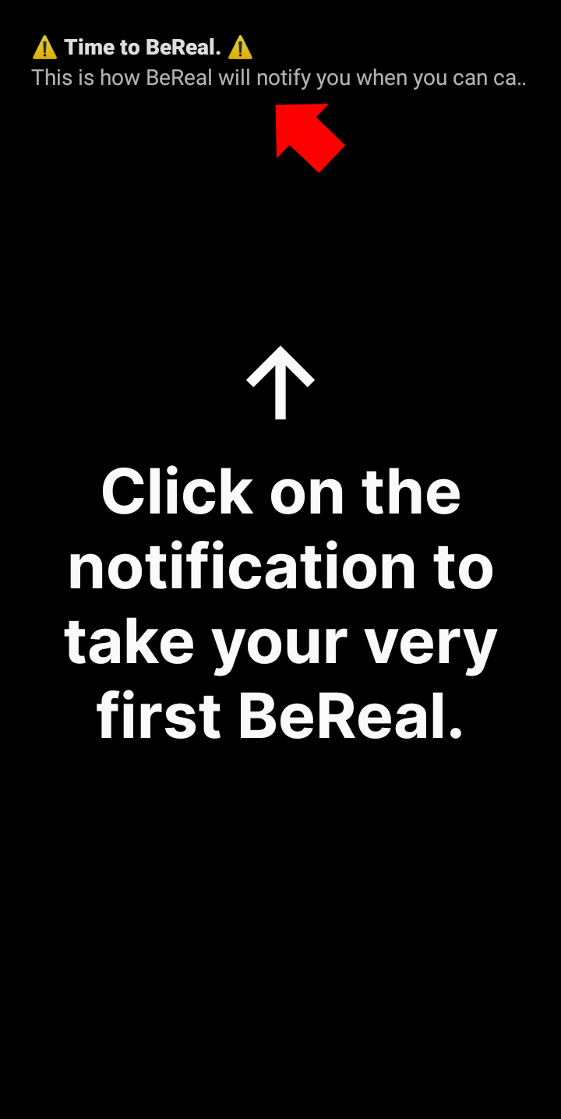
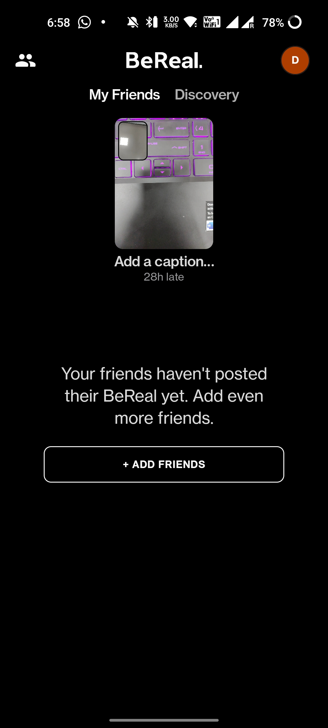
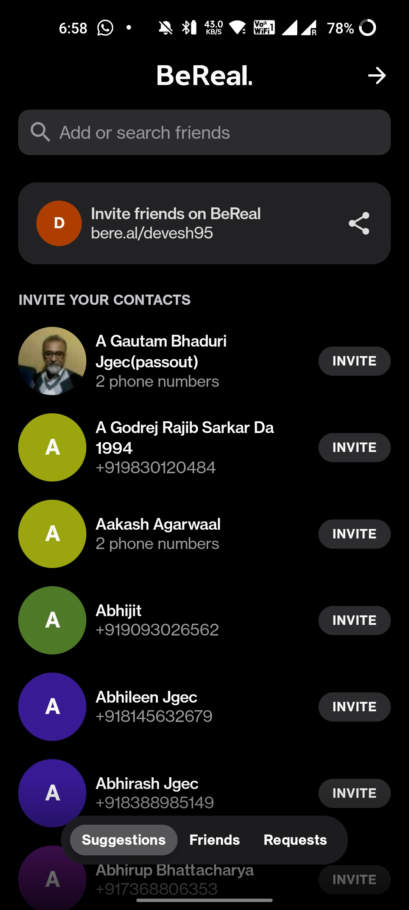
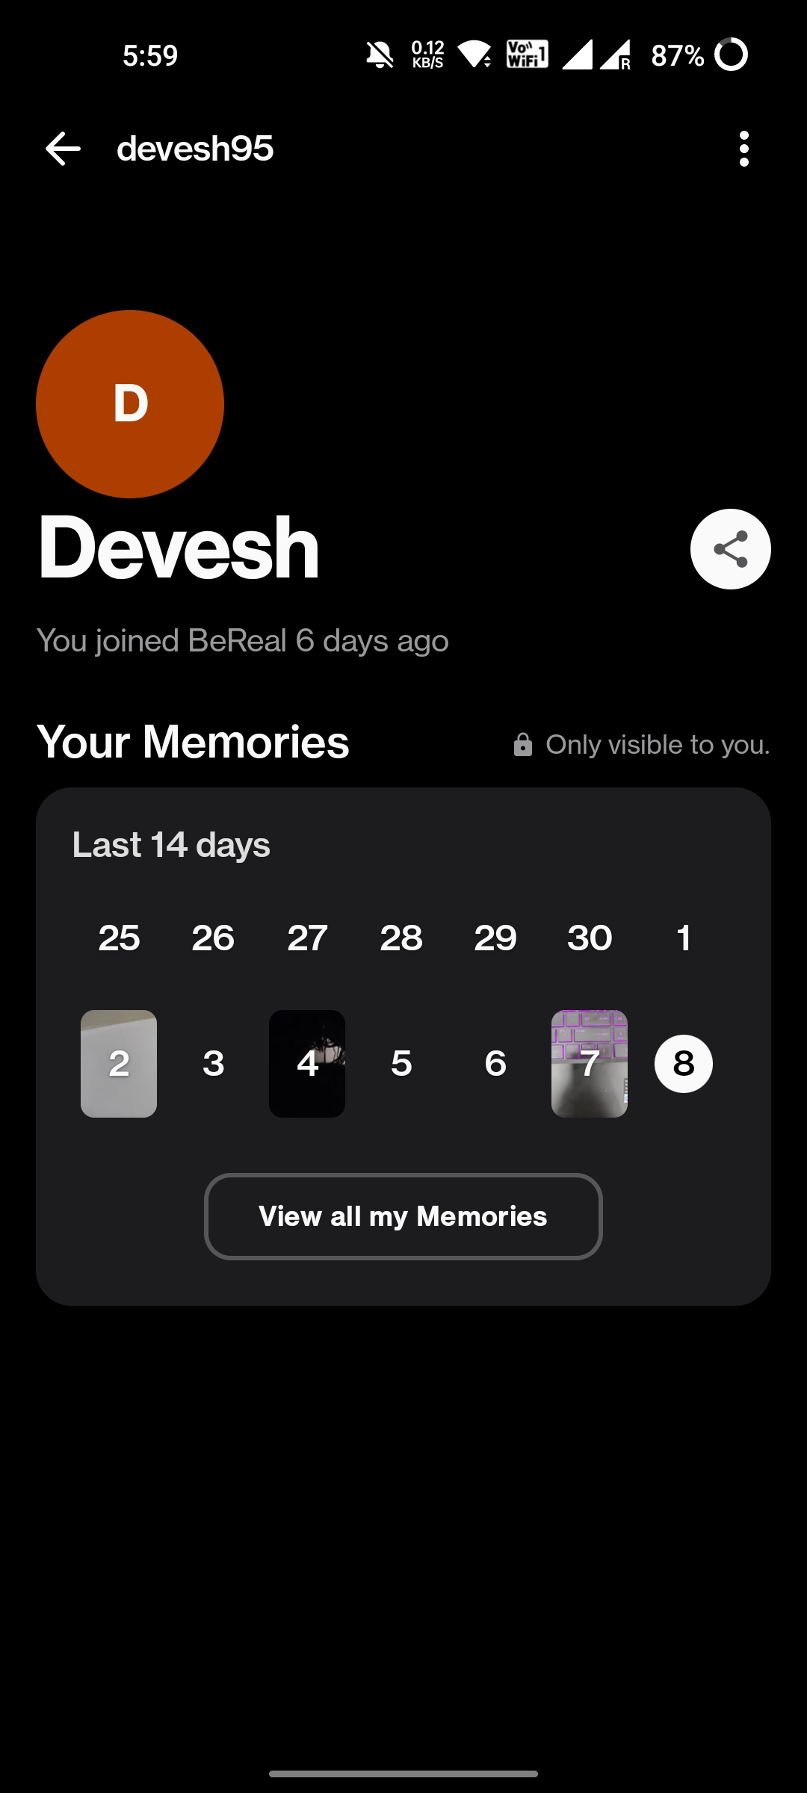
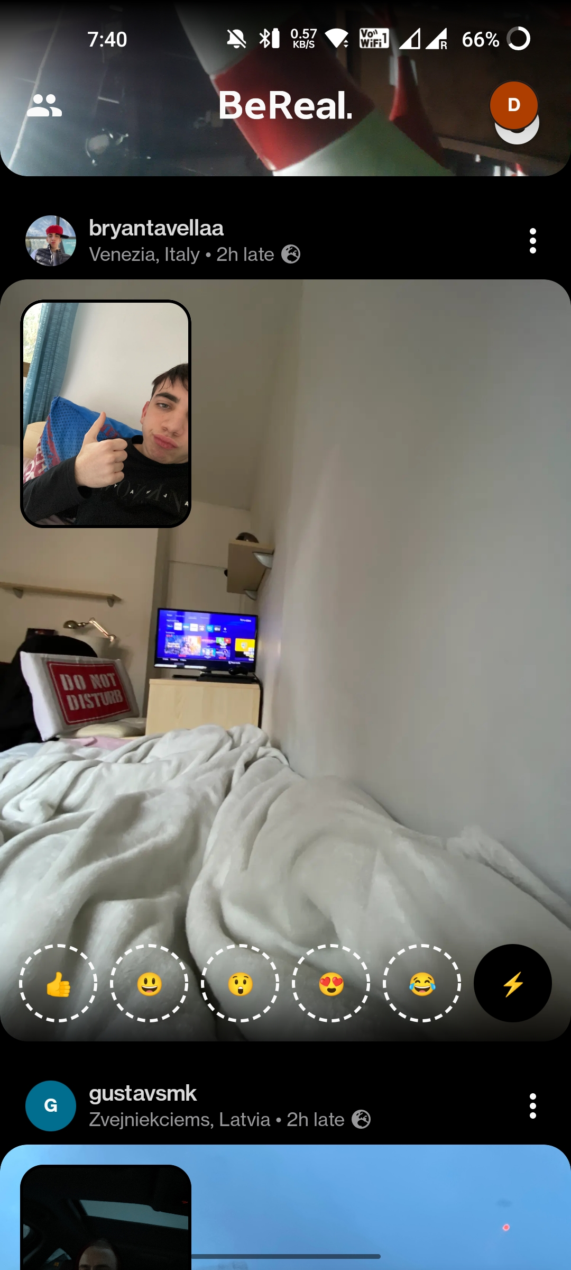
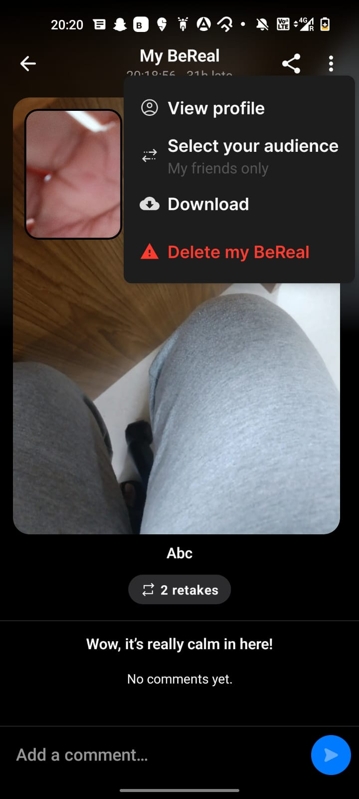
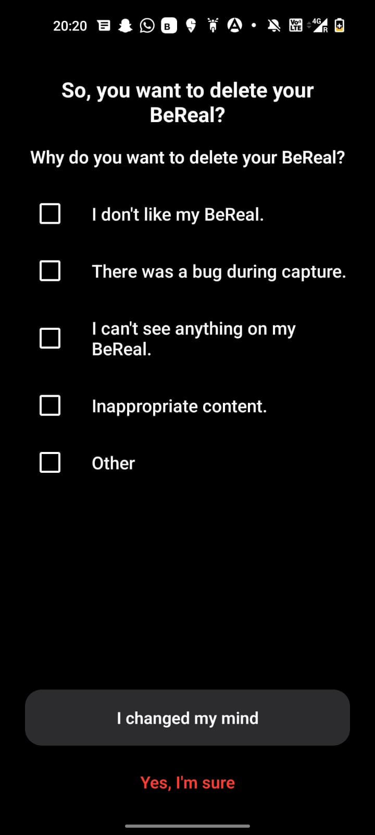


Overview
Influencer Persona
User Journey
Feature Improvements
Success Metrics
1. Onboarding
3. Account Settings/Notification Centre
2. In App Experience
Experiencing
Easy and simple app to use
No extra editing tools enabling a more realistic and authentic post
Doesn’t demand constant attention
Positioned as an anti-social media app
Random notification timing
Boring app UI
App has very niche usage
Taking the first BeReal photo
Add Friends
Go back in time with your Memories
React to posts and create your own emoji
Deleting BeReal post

Slide 5
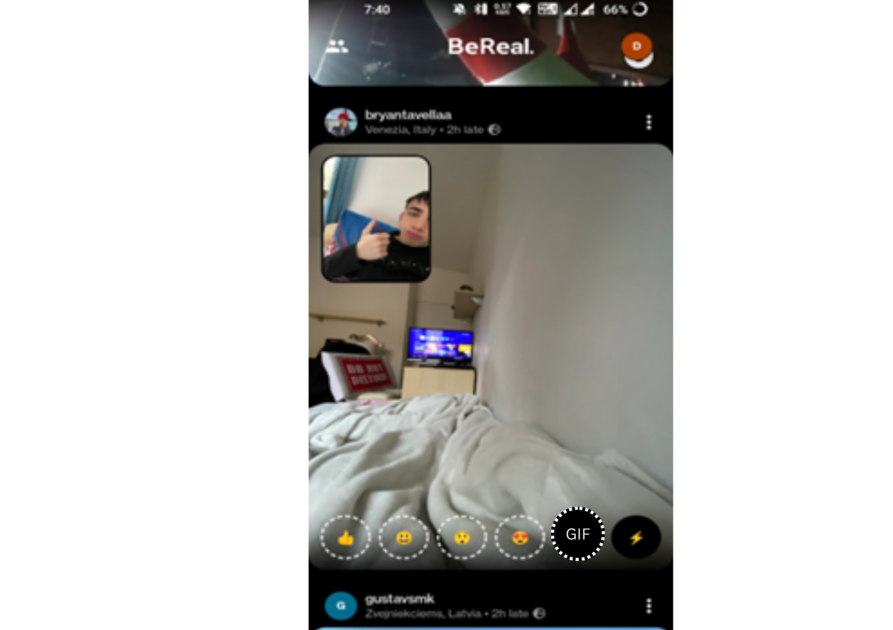
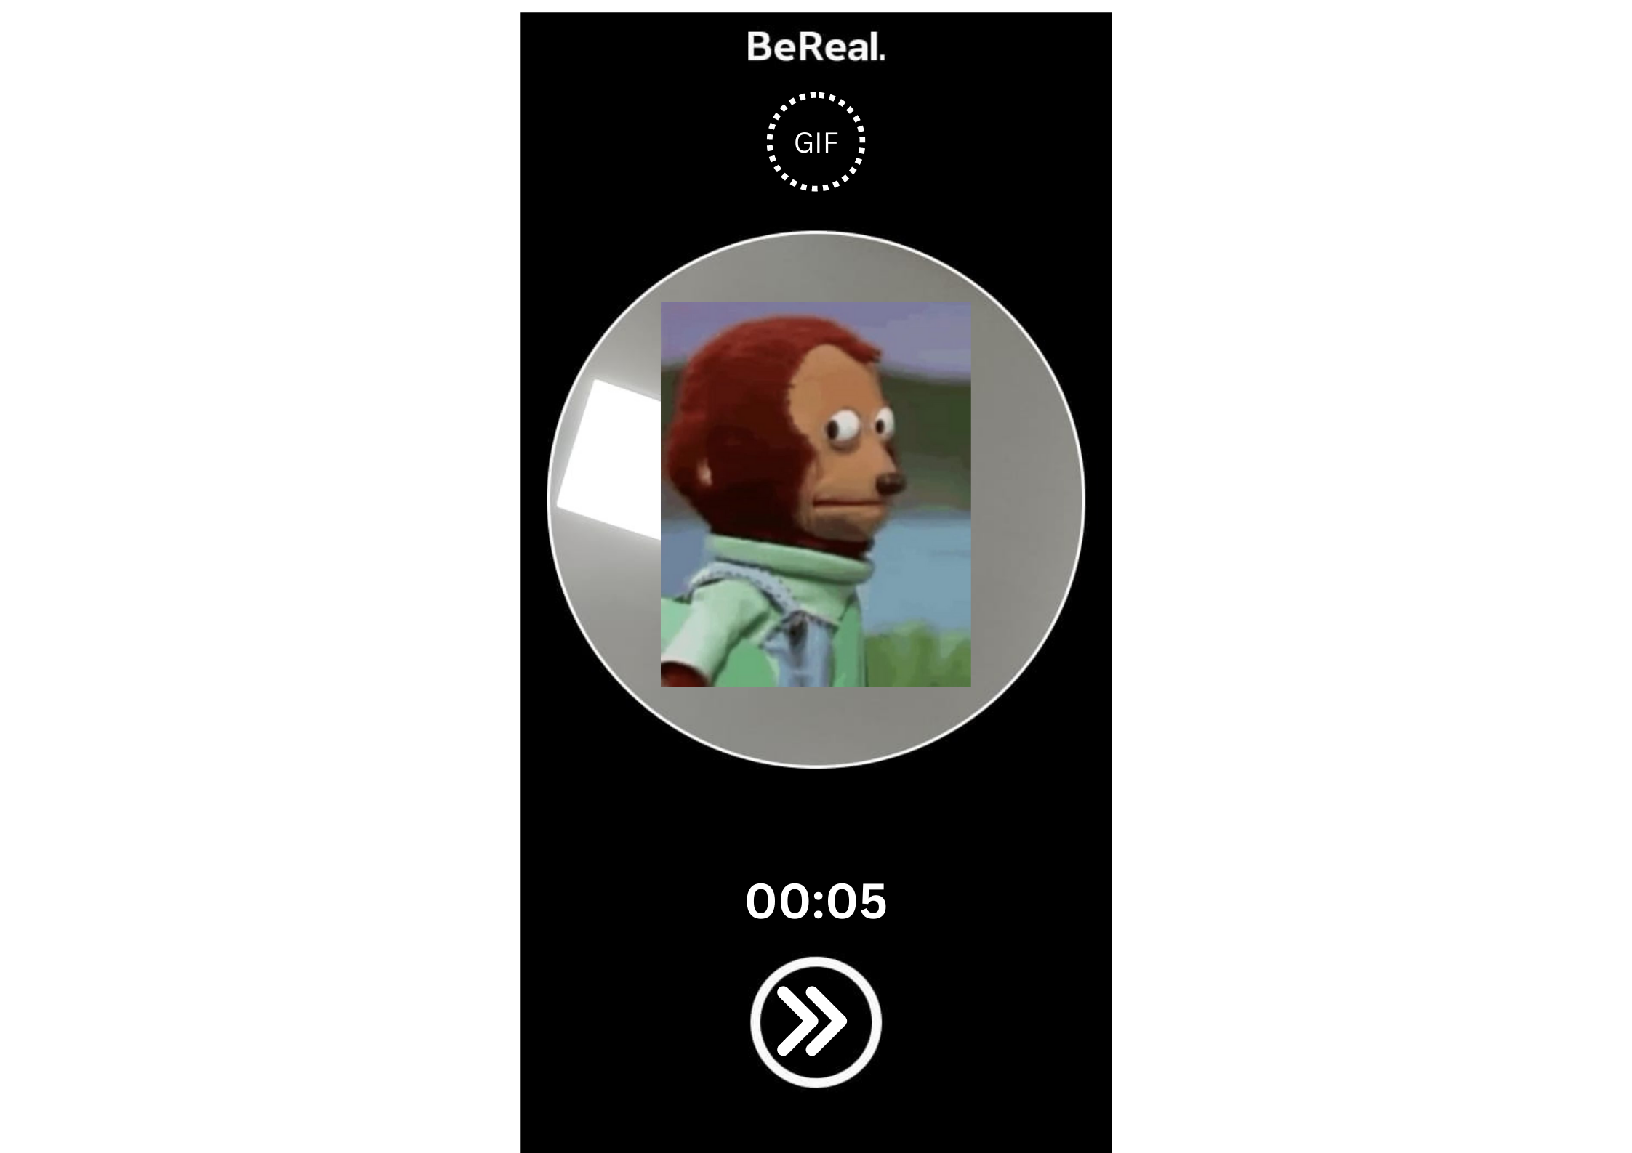
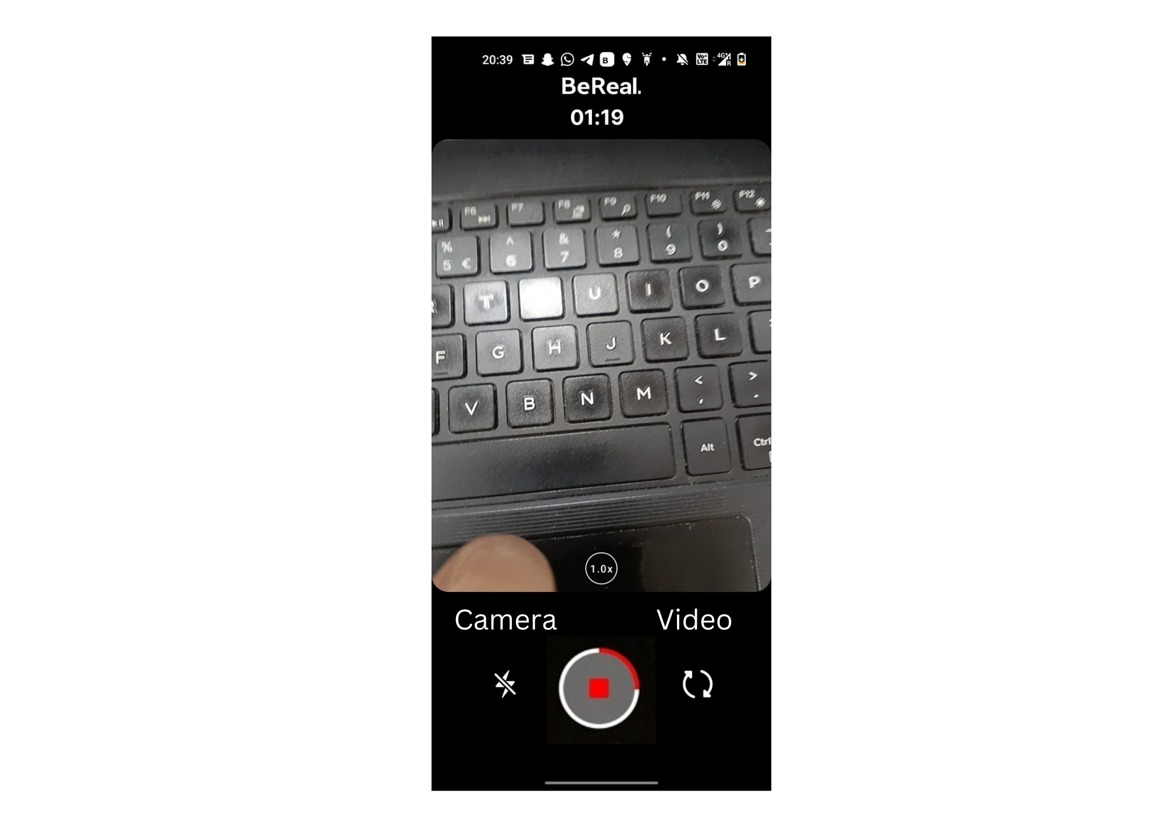
Overview
Influencer Persona
User Journey
Feature Improvements
Success Metrics
Feature #1: GIFy
Feature #2: BeReal ‘Reals’
Other Recommendations
Increase the time limit to capture a photo to 3-5 minutes
Keeping the captions above the post would drive interest and hence engagement
Notification timings to be in discretion with user. The option is to be introduced in the notification centre of account settings
Since, the app’s motive is to capture candid moments, introducing Reals to capture videos of candid moments which users can share. The feature is suggested to be introduced alongside the already existing photo feature. The time count of the video would be visible on the top of the recording screen.
The option of allowing users to post multiple times during the day is to be explored.
On implementation, a higher rate of onboarding of users is expected to observed.
Introducing GIFy feature to create GIF. The option is suggested to be introduced alongside the reaction emojis. Users on clicking would be able create their own 5 sec GIFs where the front camera would capture the reaction.

Slide 6
Overview
Influencer Persona
User Journey
Feature Improvements
Success Metrics
Indicators
KPI
Dimension
North Star Metric
User Engagement: Reactions, Comments & Shares
Applause Rate, Average Engagement Rate, Amplification Rate
Breadth
Number of users reacting and posting on the BeReal app
App Reach: new user onboarding, existing user retention
# of new users onboarded, # of active users, Churn rate
Depth
Usage Engagement Frequency
Posts, Reactions, Comments per day or per week or per month
Frequency
Average Duration Spent
Tracking time spent by user in the section will enable understand user likelihood of conversion
# of clicks/impressions
Daily/weekly tracking would enable tracking # of users accessing the feature
Drop-off Rates
High Drop-off rates would show low interest in the feature
Bounce Rate & Retention Rate
Decrease in Bounce rate shows more engagement of customers and increase in the # of orders exhibits Retention
CTRs of new feature
Daily/weekly tracking would enable tracking of user engagement with the features
Increase in # of app downloads
Will show new Customer acquisitions post launch

Slide 7
Overview
User Persona
User Journey
Feature #1: GIFy
Feature #2: BeReal Reals
Since, the app’s motive is to capture candid moments, introducing Reals to capture videos of candid moments which users can share. The feature is suggested to be introduced alongside the already existing photo feature. The time count of the video would be visible on the top of the recording screen.
Introducing GIFy feature to create GIF. The option is suggested to be introduced alongside the reaction emojis. Users on clicking would be able create their own 5 sec GIFs where the front camera would capture the reaction.

